Slide 1

TEK304 - Sikkerhet i mobile applikasjoner (høst '19) TEK304 - Security in Mobile Applications (Autumn '19)

Slide 2
What am I doing?
Responsible for:
Security in Mobile Applications
Intelligent systems
Education
BSc in Computer Science
MSc in Computer Science
PhD in IT (software engineering track) – Web Service, SOA, Mobile Applications, and HCI
Associate Professor at Kristiania University College
Researches: Mobile applications, Software architecture, Mulsemedia, E-Learning, and Business Process Engineering.

Slide 3

Student’s Expectations
Scientific, Technical, Standards, etc.

Slide 4
Reference resources
The Mobile Application Hacker's Handbook by Dominic Chell, Tyrone Erasmus, Shaun Colley, Ollie Whitehouse
Various Web resources

Slide 5
TEK304 - Security in Mobile Applications (Autumn '19)
Credits | 7’5
Teaching language
Program | Required at Bachelor of IT - Frontend and Mobile Development
Absolute prerequisites | PGR201 Android programming, subsidiary PG4600 Mobile development
Recommended prerequisites | None
Teaching | Autumn
Course coordinator

Slide 6
Objective
The course aims to provide an introduction to the vulnerability of mobile applications to attacks. What different types of threats exist, and how can one guard against these? The course addresses general threats, regardless of operating system, but focuses in particular on securing applications on iOS and Android platform.

Slide 7
Learning outcome
Knowledge - the candidate must have knowledge of the different types of threats that exist for mobile applications in general, and for applications on the iOS and Android platforms in particular have knowledge of the types of attacks that have been most dominant in recent times have the necessary knowledge of the structure of the iOS and Android platforms related to possible threats know about security models for iOS and Android

Slide 8
Learning outcome (cont’d)
Skills - the candidate should be able to identify possible vulnerabilities in mobile applications on the iOS and Android platforms be able to develop measures to secure mobile applications on the iOS and Android platforms General competence - the candidate must be able to account for the threat picture around mobile applications be able to explain how security can be incorporated as a natural element when developing mobile applications Examination Individual written exam 25 %, no aids Individual written exam 75 % hand in.

Slide 9
Course content
Week | Topic | Resource
34 (Aug. 22) | Introduction: Motivation, Mobile Application (In)security | (Chapter 1, Page 1)
35 | Introduction: Threats to Mobile Security, Mobile Security Technical Controls, Mobile Security Principles | Web
36 | Analysing Android Applications Attacking Android Applications | (Chapter 6, Page 173) (Chapter 7, Page 247)
37 | Identifying and Exploiting Android Implementation Issues Writing Secure Android Applications | (Chapter 8, Page 353) (Chapter 9, Page 427)
38 | Guest lecture 1: Organizational perspectives
39 | Identification, analysis and risk assessment on Android

Slide 10
Course content (cont’d)
Week | Topic | Resource
40 | Analyzing iOS Applications Attacking iOS Applications | (Chapter 2, Page 17) (Chapter 3, Page 69)
41 | Guest lecture 2: Mobile application hacking
42 | Identifying iOS Implementation Insecurities Writing Secure iOS Applications | (Chapter 4, Page 133) (Chapter 5, Page 149)
43 | Guest lecture 3: Cross-Platform Mobile Applications
44 | Secure REST based communication Cross Platform Mobile Applications | Web and Other sources (Chapter 18, Page 729)
45 | Exam preparation Course summary

Slide 11
Today’s Lecture
Motivation
Mobile Application (In)security
Exercises & next time

Slide 12
Motivation

Slide 13
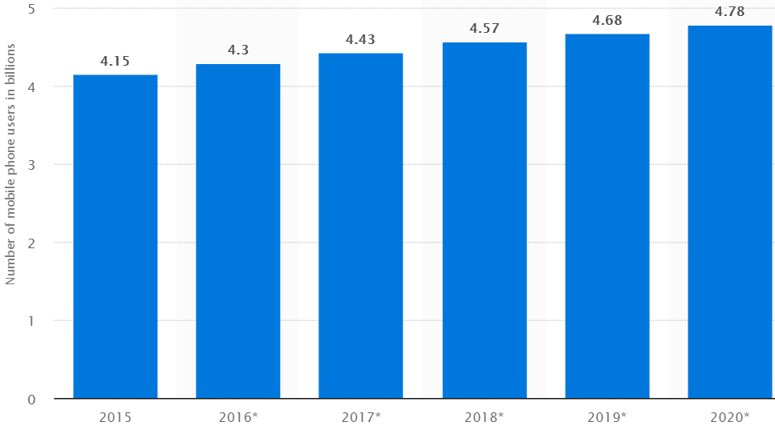
Number of smartphone users in the world (in billion)

Slide 14
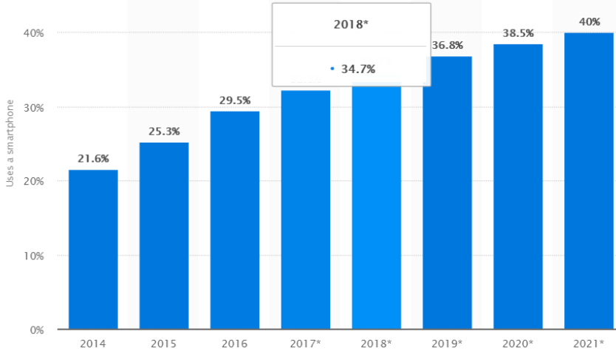
Smartphone penetration rate in the world

Slide 15
Online shopping
Using the Internet in shopping
The role of smartphones in this respect is immense.
In 2016, 58.3 percent of global internet users had purchased products online.
Various countries of different experiences in this respect.

Slide 16
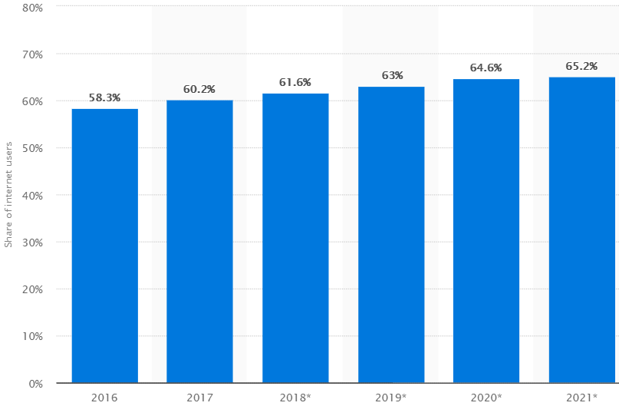
Percentage of Internet users online shopping

Slide 17
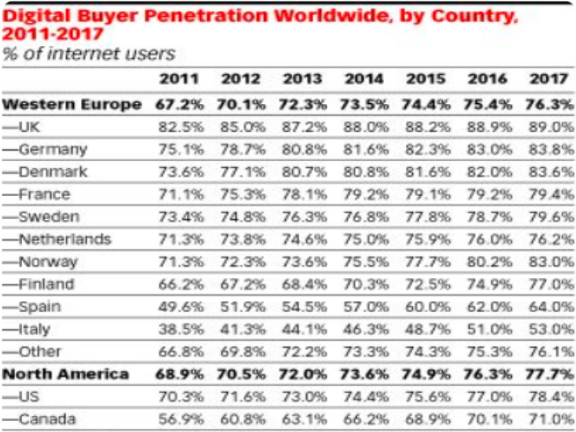
Internet penetration rate in the world

Slide 18
Mobile Application (In)security

Slide 19
Mobile Application (In)security
The Evolution of Mobile Applications
Common Mobile Application Functions
Benefits of Mobile Applications
Mobile Application Security
The OWASP Mobile Security Project
The Future of Mobile Application Security

Slide 20
Introduction
Mobile computing has changed the world; in particular, the way you work, interact, and socialize.
It has brought infinite possibilities to your fingertips.
Mobile application development is now so popular that Apple’s trademark, “There’s an app for that” is bordering on reality.

Slide 21
Introduction ...
However, the vast majority of mobile applications are far from secure.
Here, we categorize these vulnerabilities based on the Open Web Application Security Project (OWASP) Top 10 mobile security risks.
Overview of some of the open source mobile security tools endorsed by OWASP.

Slide 22
The Evolution of Mobile Applications
The first mobile phone applications were developed by handset manufacturers.
Documentation was sparse, and little information existed in the public domain on the operating internals.
This can be attributed to vendors’ fear that opening the platforms to third-party development might have exposed trade secrets.

Slide 23
The Evolution of Mobile Applications …
The early applications look the manufacturer-based apps found on today’s phone- contacts, calendars, Nokia’s popular Snake, etc.
When smartphones emerged as the successor to personal digital assistants (PDAs), application development really began to take off.
Mobile applications have evolved by taking advantage of enhanced platforms- GPS, camera, battery life, displays, and processor.

Slide 24
The Evolution of Mobile Applications …
Third-party application development emerged in 2008 when Apple announced the first distribution service, the App Store, following the release of first iPhone.
Google closely followed with the Android Market (today’s Play Store). Then, other markets exist like Windows Phone Store, the Amazon Appstore, and the BlackBerry World.
However, the increased competition for third-party application development has left the developer markets somewhat fragmented.

Slide 25
The Evolution of Mobile Applications …
Majority mobile applications are platform specific, and software vendors work on different operating systems, programming languages, and tools to provide multi-platform coverage.
That is, iOS developed using Objective-C (now swift), Android, BlackBerry using Java (up until BlackBerry 10, which also uses Qt) and Windows Phone applications using the .NET Framework.
However, a recent increase has occurred in the development of cross-platform mobile applications to reduce development costs and overheads.

Slide 26
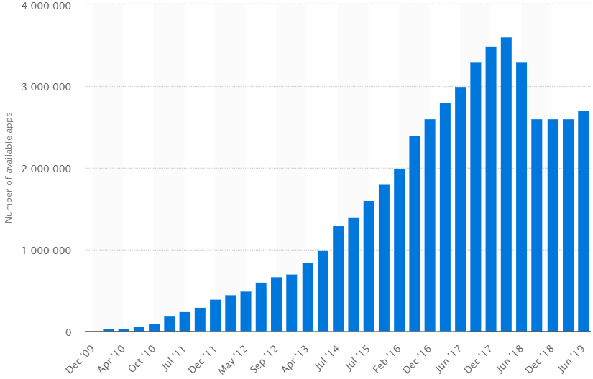
Google distribution stores, there are believed to be more than 3 million (2018) applications (statista.com)

Slide 27
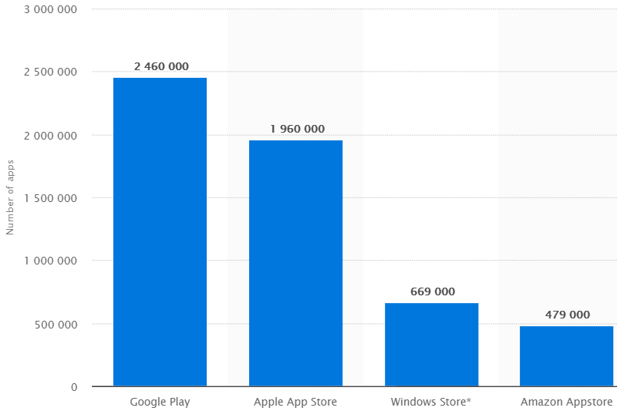
Number of apps available in leading app stores as of 2nd quarter 2019 (statista.com)

Slide 28

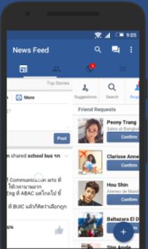
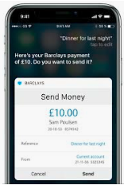
Common Mobile Application Functions:
The Google’s distribution covers Apps in a wide range of functions including the following:
Shopping (e.g, Amazon)
Online banking (e.g., Barclays)
Social networking (e.g., Facebook)

Slide 29
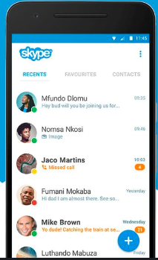
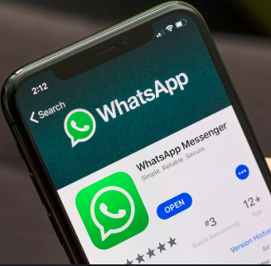
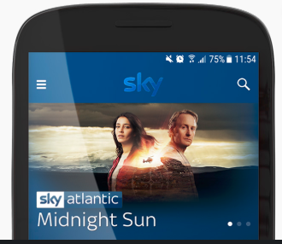
Common Mobile Application Functions …
Voice chat (e.g., Skype)
Streaming (e.g., Sky Go)
Instant Messaging (e.g., WhatsApp)

Slide 30

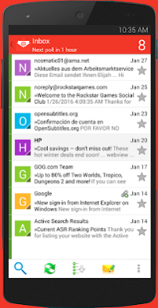
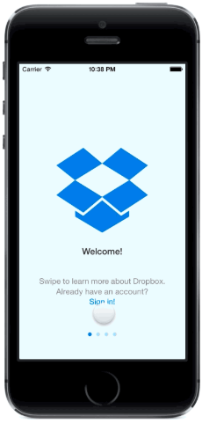
Common Mobile Application Functions …
Games (e.g., Angry Birds)
File sharing (e.g., Dropbox)
E-mail (e.g., Gmail)

Slide 31
Common Mobile Application Functions …
Functionality of mobile apps often overlap with web applications.
In many cases both mobile and web use the same core server-side APIs and display smartphone-compatible interface at presentation layer.
In addition to distribution markets, mobile apps have been widely adopted in key business functions which provide access to highly sensitive corporate data.

Slide 32
Common Mobile Application Functions …
Examples of apps used in business, document storage, travel and expenses, HR applications, internal applications(corporate intranet), instant messaging, etc.
The business apps are considered to be “internal” applications and are typically developed in-house or specifically for an organization which also use VPN.
“geo fencing” is being introduced whereby GPS is used to ascertain whether a user is in a certain location thereby tailors or restricts functionality based on the result.

Slide 33
Benefits of Mobile Applications
Commercial incentives and benefits of mobile applications are among the reasons for their rapid rise. However, technical factors like the following have also contributed to their success.
HTTP is widely adopted in mobile deployments.
The technically advanced features and a better user experience.

Slide 34
Benefits of Mobile Applications ...
Example of such features include enhancements in battery life and processing power allow the modern smartphone to run not just one but many applications at once and for longer.
Improvements in cellular network (3G and 4G high-speed Internet access) allowed mobile applications to take full advantage to access online services.
The use of common technologies and languages (e.g., Java) in mobile development has helped with the mobile revolution.

Slide 35
Mobile Application Security
Mobile applications are affected by a range of security vulnerabilities.
Many of the attacks are inherited from traditional attacks against web and desktop applications.
Attacks specific to the mobile- arise due to the way mobile applications are used and the relatively unique entry points and the attack surfaces it has.

Slide 36
Mobile Application Security … attack surfaces
Mobile communication may often occur over an untrusted or insecure network such as hotel or café Wi-Fi, mobile hotspot, or cellular.
Mobile devices are carried with you wherever you go, creating many opportunities for them to be lost or stolen.
Malware is widespread within the unofficial distribution markets, and developers must be conscious of attacks from other applications.
Mobile applications can derive input from a large number of possible sources as entry points – NFC, Bluetooth, SMS, camera, USB, etc.

Slide 37
Mobile Application Security …
The most serious attacks against mobile applications are those that expose sensitive data or facilitate a compromise on the host device.
These vulnerabilities are more to the mobile end user’s data and device as opposed to all other users of the service.
Server-side vulnerabilities can expose unrestricted access to back end systems. Thus, although they pose the greatest risk to mobile application deployments, these issues are well documented and understood.

Slide 38
Mobile Application Security …
Mobile application security has not fully matured as an area of focus and majority of mobile applications are still considered insecure.
Mobile applications tested since 2012 were found to be affected by some common categories of client-side vulnerability.

Slide 39
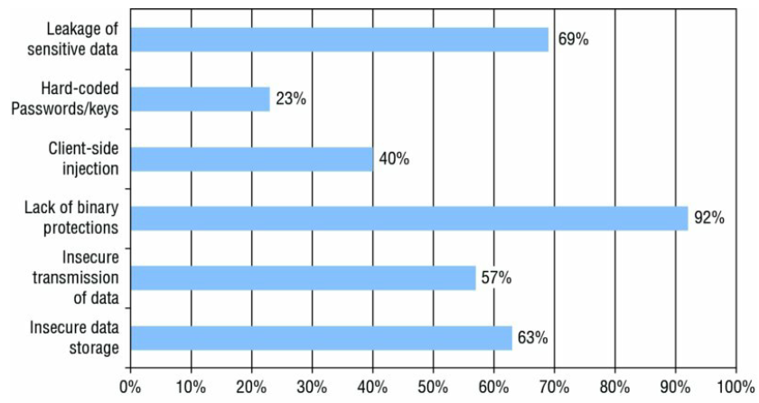
Mobile Application Security …

Slide 40
Key Problem Factors for Mobile Security
Most occur when an application must handle or protect sensitive data or process data that has originated from an untrusted source:
Underdeveloped Security Awareness - developers cannot trust the host operating system or even their own application (lack of awareness on the many attack surfaces).
Ever-changing Attack Surfaces – new vulnerabilities that may undermine the accepted defences may happen even in the middle of a project (e.g. discovery of Apple’s “goto fail” vulnerability).

Slide 41
Key Problem Factors for Mobile Security ...
Economic and Time Constraints – not having permanent (expensive) security expertise – hence testing finds only low-hanging fruit.
Custom Development – in-house or third-party dev’t teams may not have full awareness of the code and misuse could lead to security defects.
E.g., the vulnerability occurred by the addJavascriptInterface that affected the Android Webview component which resulted in a remote compromise of the device.

Slide 42
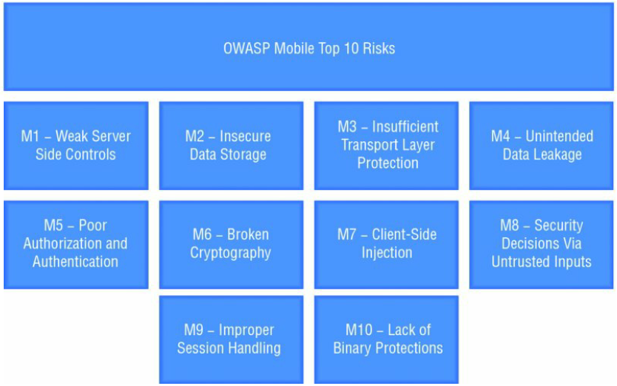
The OWASP Mobile Security Project
Similar to the renowned OWASP Top 10, the Mobile Security Project defines an equivalent Top 10 Mobile Risks as below:

Slide 43
OWASP Mobile Security Tools
iMAS - Deals with how to reduce an adversary’s ability to reverse engineer, manipulate, and exploit an iOS application. https://www.owasp.org/index.php/OWASP_iMAS_iOS_Mobile_Application_Security_Project
GoatDroid - Provide coverage for most of the OWASP Top 10 Mobile Risks as a good starting point for beginners in Android application security.
https://www.owasp.org/index.php/Projects/OWASP_GoatDroid_Project
iGoat - It is a training application for improving your iOS assessment knowledge – covers local storage, the key chain, SQL injection, and more.
https://www.owasp.org/index.php/OWASP_iGoat_Project

Slide 44
The Future of Mobile Application Security
Classic vulnerabilities such as insecure data storage and insufficient transport security will continue to be prevalent.
New categories of attacks to arise following advances in mobile technologies.
New hardware components and increased adoption in existing technologies will lead to the discovery of new vulnerabilities.

Slide 45
The Future of Mobile Application Security …
Criminals will seek to take advantage of vulnerabilities for financial gain - banking malware and premium-rate SMS fraud will continue.
Browser-based and Hybrid applications will continue to use commercial and freely available frameworks which are also potential threats.
Despite all the changes in mobile applications no signs exist that the classic attacks are diminishing.

Slide 46
Exercises & next time
Now it's time for group work/Lab!
In this room (A5-10) until 4PM.
Today's exercises:
Characteristics of mobile applications
Security in mobile application
Main topics, next time: Introduction (cont’d):
Threats to Mobile Security
Mobile Security Technical Controls,
Mobile Security Principles.

